Slide 1
Time Complexity
The time complexity is a function that gives the amount of time required by an algorithm to run to completion.
• Worst case time complexity: It is the function defined by the maximum amount of time needed by an algorithm for an input of size n.
• Average case time complexity: The average-case running time of an algorithm is an estimate of the running time for an “average” input. Computation of average-case running time entails knowing all possible input sequences, the probability distribution of occurrence of these sequences, and the running times for the individual sequences.
• Best case time complexity: It is the minimum amount of time that an algorithm requires for an input of size n.

Slide 2
There are four rules to count the operations:
Rule 1: for loops - the size of the loop times the running time of the body
The running time of a for loop is at most the running time of the statements inside the loop times the number of iterations.
for( i = 0; i < n; i++)
sum = sum + i;

Slide 3
a. Find the running time of statements when executed only once:
The statements in the loop heading have fixed number of operations, hence they have constant running time O(1) when executed only once.
The statement in the loop body has fixed number of operations, hence it has a constant running time when executed only once.

Slide 4
b. Find how many times each statement is executed.
for( i = 0; i < n; i++) // i = 0; executed only once: O(1)
// i < n; n + 1 times O(n)
// i++ n times O(n)
// total time of the loop heading:
// O(1) + O(n) + O(n) = O(n)
sum = sum + i; // executed n times, O(n)
The loop heading plus the loop body will give: O(n) + O(n) = O(n).
Loop running time is: O(n)

Slide 5
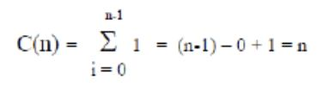
Mathematical analysis of how many times the statements in the body are executed
If
a) the size of the loop is n (loop variable runs from 0, or some fixed constant, to n) and
b) the body has constant running time (no nested loops) then the time is O(n)

Slide 6
Rule 2: Nested loops – the product of the size of the loops times the running time of the body
The total running time is the running time of the inside statements times the product of the sizes of all the loops
sum = 0;
for( i = 0; i < n; i++)
for( j = 0; j < n; j++)
sum++;
Applying Rule 1 for the nested loop (the ‘j’ loop) we get O(n) for the body of the outer loop.
The outer loop runs n times, therefore the total time for the nested loops will be
O(n) * O(n) = O(n*n) = O(n^2)

Slide 7
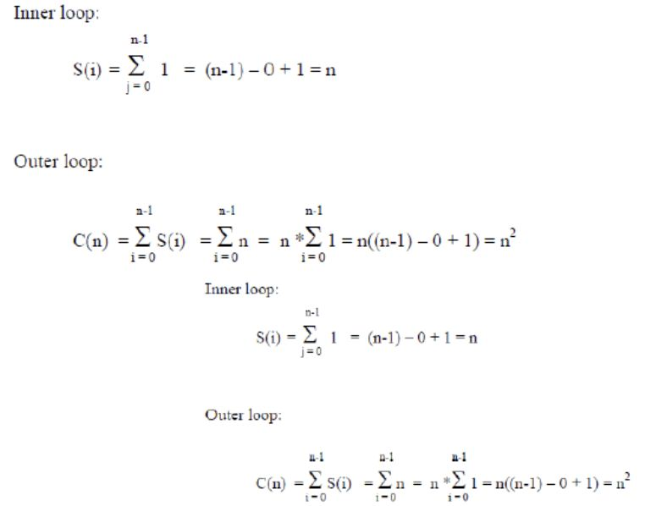
Analysis:

Slide 8
What happens if the inner loop does not start from 0?
sum = 0;
for( i = 0; i < n; i++)
for( j = i; j < n; j++)
sum++;
Here, the number of the times the inner loop is executed depends on the value of i
i = 0, inner loop runs n times
i = 1, inner loop runs (n-1) times
i = 2, inner loop runs (n-2) times
…
i = n – 2, inner loop runs 2 times
i = n – 1, inner loop runs once.
Thus we get: ( 1 + 2 + … + n) = n*(n+1)/2 = O(n2)

Slide 9
General rule for nested loops:
Running time is the product of the size of the loops times the running time of the body.
Example:
sum = 0;
for( i = 0; i < n; i++)
for( j = 0; j < 2n; j++)
sum++;
We have one operation inside the loops, and the product of the sizes is 2n2
Hence the running time is O(2n2) = O(n2)

Slide 10
Note: if the body contains a function call, its running time has to be taken into consideration
sum = 0;
for( i = 0; i < n; i++)
for( j = 0; j < n; j++)
sum = sum + function(sum);
Assume that the running time of function(sum) is known to be log(n).
Then the total running time will be O(n2*log(n))

Slide 11
Rule 3: Consecutive program fragments
The total running time is the maximum of the running time of the individual fragments
sum = 0;
for( i = 0; i < n; i++)
sum = sum + i;
sum = 0;
for( i = 0; i < n; i++)
for( j = 0; j < 2*n; j++)
sum++;
The first loop runs in O(n) time, the second - O(n2) time, the maximum is O(n2)

Slide 12
Rule 4: If statement
if C
S1;
else
S2;
The running time is the maximum of the running times of S1 and S2.

Slide 13
Summary
Steps in analysis of non-recursive algorithms:
• Decide on parameter n indicating input size
• Identify algorithm’s basic operation
• Check whether the number of time the basic operation is executed depends on some additional
property of the input. If so, determine worst, average, and best case for input of size n
• Count the number of operations using the rules above.

Slide 14
ASYMPTOTIC NOTATIONS
The main idea of asymptotic analysis is to have a measure of efficiency of algorithms that doesn’t depend on machine specific constants, and doesn’t require algorithms to be implemented and time taken by programs to be compared.
Asymptotic notations are mathematical tools to represent time complexity of algorithms for asymptotic analysis.
The following 3 asymptotic notations are mostly used to represent time complexity of algorithms.

Slide 15
Big O Notation:
The Big O notation defines an upper bound of an algorithm, it bounds a function only from above. For example,
consider the case of Insertion Sort. It takes linear time in best case and quadratic time in worst case.
We can safely say that the time complexity of Insertion sort is O(n³). Note that O(n²) also covers linear time.
If we use Θ notation to represent time complexity of Insertion sort, we have to use two statements for best and worst cases:
1.The worst case time complexity of Insertion Sort is Θ(n³).
2. The best case time complexity of Insertion Sort is Θ(n²).
The Big O notation is useful when we only have upper bound on time complexity of an algorithm.
Many times we easily find an upper bound by simply looking at the algorithm.

Slide 16
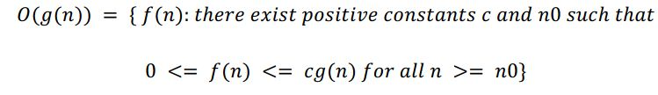
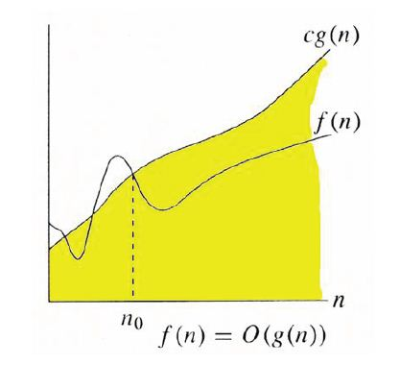

Slide 17
For example, consider the following expression. logn = O (n)
Let f(n)= logn , g(n)= n
When,
n=1 f(n)=0 g(n)=1
n=10 f(n)=3.3 g(n)=10
N=100 f(n)=6.64 g(n)=100
N=1000 f(n)=10 g(n)=1000
Hence,
0 <= f(n) <= c *g(n) for all n>=n₀
f(n) =O(g(n))

Slide 18
Ω Notation:
Just as Big O notation provides an asymptotic upper bound on a function, Ω notation provides an asymptotic lower bound.
Ω Notation can be useful when we have lower bound on time complexity of an algorithm.
As discussed in the previous post, the best case performance of an algorithm is generally not useful;
the Omega notation is the least used notation among all three.

Slide 19
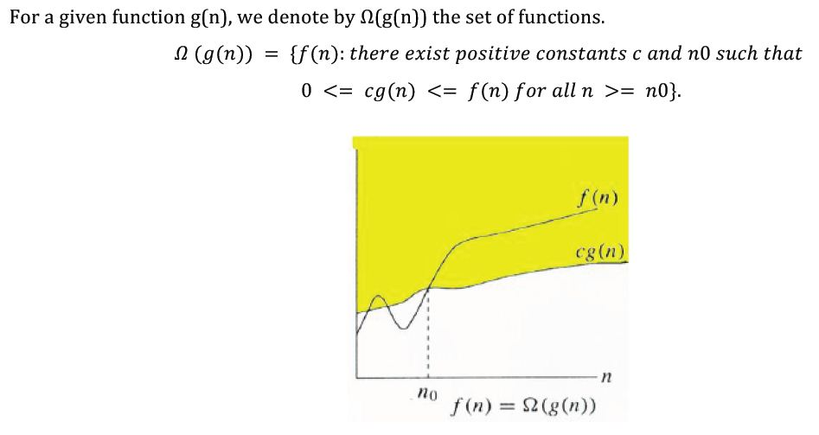

Slide 20
For example, consider the following expression. O (n)= logn
Let f(n)= n , g(n)= logn
When,
n=1 f(n)=1 g(n)=0
n=10 f(n)=10 g(n)=3.3
N=100 f(n)=100 g(n)=6.64
N=1000 f(n)=1000 g(n)=10
Hence,
0 <= c *g(n) <= f(n) for all n>=n₀
f(n) = Ω(g(n))

Slide 21
Θ Notation:
The theta notation bounds a function from above and below, so it defines exact asymptotic behavior.
A simple way to get Theta notation of an expression is to drop low order terms and ignore leading constants.
For example, consider the following expression. 3n³ + 6n² + 6000 = Θ (n³)
Dropping lower order terms is always fine because there will always be a n0 after which Θ (n³) beats Θ (n²)
irrespective of the constants involved. For a given function g(n), we denote Θ(g(n)) is following set of functions.
Θ (g(n)) = {f(n): there exist positive constants c1, c2 and n₀
such that 0 <=c1*g(n) <= f(n) <= c2 *g(n) for all n>=n₀

Slide 22
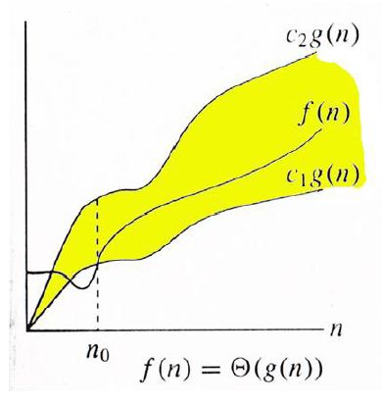
The above definition means, if f(n) is theta of g(n), then the value f(n) is always between c1*g(n) and c2*g(n) for large values of n (n >= n0).
The definition of theta also requires that f(n) must be non-negative for values of n greater than n0.

Slide 23
For example, consider the following expression. 6n² +8n = Θ (n²)
Let f(n)= 6n² + 8 , g1(n)= 4n² g2(n)=10n² if c1=4 c2=10
When,
n=1 g1(n)=4 f(n)=14 g2(n)=10
n=10 g1(n)=400 f(n)=608 g2(n)=1000
N=100 g1(n)=40000 f(n)=60008 g2(n)=100000
Hence,
0 <=c1*g(n) <= f(n) <= c2 *g(n) for all n>=n₀
f(n) =Θ(g(n))

Slide 24
Properties of Big-O Notation
Fact 1 (Transitivity)
If f(n)=O(g(n)) and g(n)=O(h(n)), then f(n)=O(h(n))
Prove it (done in class)
Fact 2
If f(n)=O(h(n)) and g(n)=O(y(n)), then f(n)+g(n)=max(O(h(n),O(y(n)) )
If f(n)=O(h(n)) and g(n)=O(y(n)), then f(n)*g(n)=O(h(n)) *O(y(n))
Fact 3
The function an^{k}=O(n^{k})
Fact 4
The function n^{k}=O(n^{k+j}) for any positive j

Slide 25
Properties of Big-O Notation (cont’d)
It follows from those facts that every polynomial is big-O of n raised to the largest power
f(n) = a_{k}n^{k} + a_{k-1}n^{k-1} + . . . + a₁n¹ + a₀ = O(n^{k})
Fact 5
If f(n)=cg(n), then f(n)=O(g(n))

Slide 26
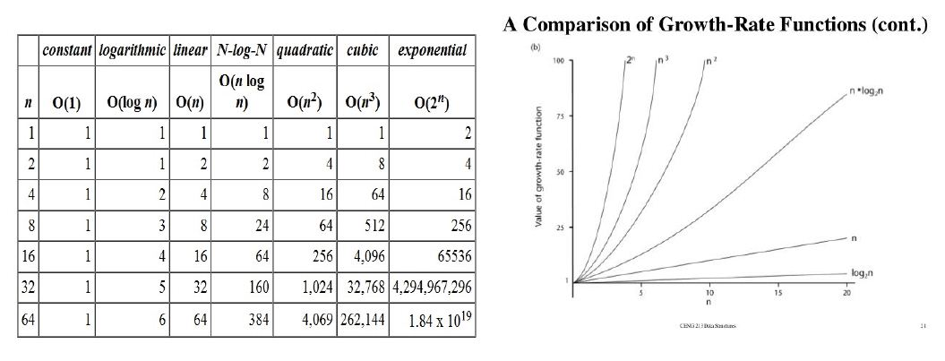
Rate of Growth functions

Slide 27
Exercises
Arrange the functions according to their order of growth
O(n),O(2^{n}), O(n²) , O(log n), O(n³) ,O(n log n), O(1)
2. True or False
3n² log n= Θ(n²)
3.Prove inequalities
3n³ + 6n² + 6000 = Θ (n³)

Slide 28
Exercise
Find Time Complexity of the algorithms
1. for (i=0 to n-1) do
For (j=i+1 to n-1)
If(A[i]==A[j])
Return false
2. Matrix Multiplication
3. for(i=0;i<n;i=i+2)
Sum=sum+I;
4. While(n>1)
{ count=count+1;
n=n/2;
}
return (count)

Slide 29
Recursion
Any function calls itself is recursive function
Recursion is used for problems when a large task can be broken down into a repetitive subtask.
Base Case
The routine will come across a subtask that it can handle without calling itself known as a base case. It stops the recursion.
Recursive Case
The routine has to call itself to complete its subtask.
Advantages
More elegant and requires few variables which makes program clean.
Replaces complex nesting code.
Disadvantages
Harder to think logic of a recursive function
Debugging is difficult
Requires more memory

Slide 30
Example
Factorial (n)
{
If (n=0)
Return(1)
Else
Return (n*fact(n-1))
}

Slide 31
Recurrence Equation
An equation that defines a sequence recursively.
It is normally in following form
T(n)=T(n-1) + n if n>0
T(0)=0

Slide 32
Deriving Recurrence Equation
Factorial (n)
{
If (n=0)
Return(1)
Else
Return (n*fact(n-1))
}
Basic Operation is Multiplication
M(n)= M(n-1)+1 if n>0
M(0)=0

Slide 33
Binary Search
// initially called with low = 0, high = N – 1
BinarySearch_Right(A[0..N-1], value, low, high) {
if (high < low)
return low
else
{
mid = low +((high – low) / 2)
if (A[mid] == value)
return mid
else if (A[mid] > value)
return BinarySearch_Right(A, value, low, mid-1)
else
return BinarySearch_Right(A, value, mid+1, high)
}
}
Recurrence Equation
Basic Operation is comparision
C(n)= C(n/2)+1 if n>1
C(1)=1

